Slide 1
Numerical Analysis (4/7) Non-linear (systems of) equations
University of Luxembourg - 2024
Master in Mathematics
Hadrien Beriot

Slide 2
Outline
1. Introduction
2. Standard algorithms (1D)
3. Systems of non-linear equations
4. Summary

Slide 3

1. Introduction

Slide 4
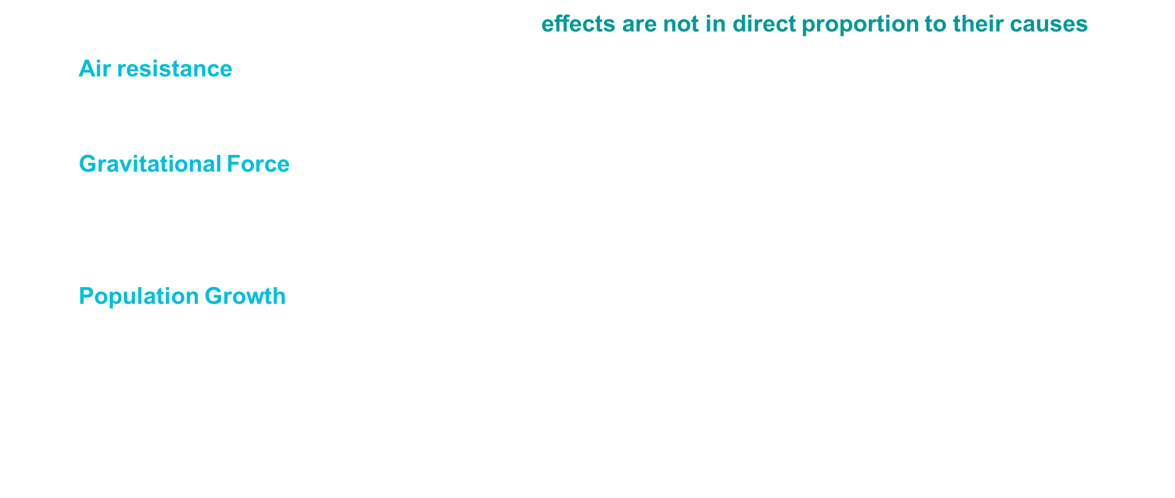
Introduction
Most relationships in nature are nonlinear in that eﬀects are not in direct proportion to their causes
Air resistance: is proportional to the square of velocity (proportionality constant $C_{d}$ = drag)
$$F_{drag} = C_{d} ∗ v^{2}.$$
Gravitational Force: inversely proportional to the square of the distance between two masses, according to Newton's law of gravitation
$F= Gm_{1}m_{2}/r^{2}$
Population Growth: In ecosystems, population growth often follows a logistic model
$$\frac{dP}{dt}​=r P\left(1−\frac{P}{K​}\right)$$
Where $r$ is the growth rate and $K$ is the carrying capacity
Often, the relationships become more nonlinear as more physical features are included.
Notes:
If you want to know the drag for a given velocity, you simply evaluate this quadratic function; but if you want to know what velocity would yield a given drag, then you must solve a quadratic equation.

Slide 5
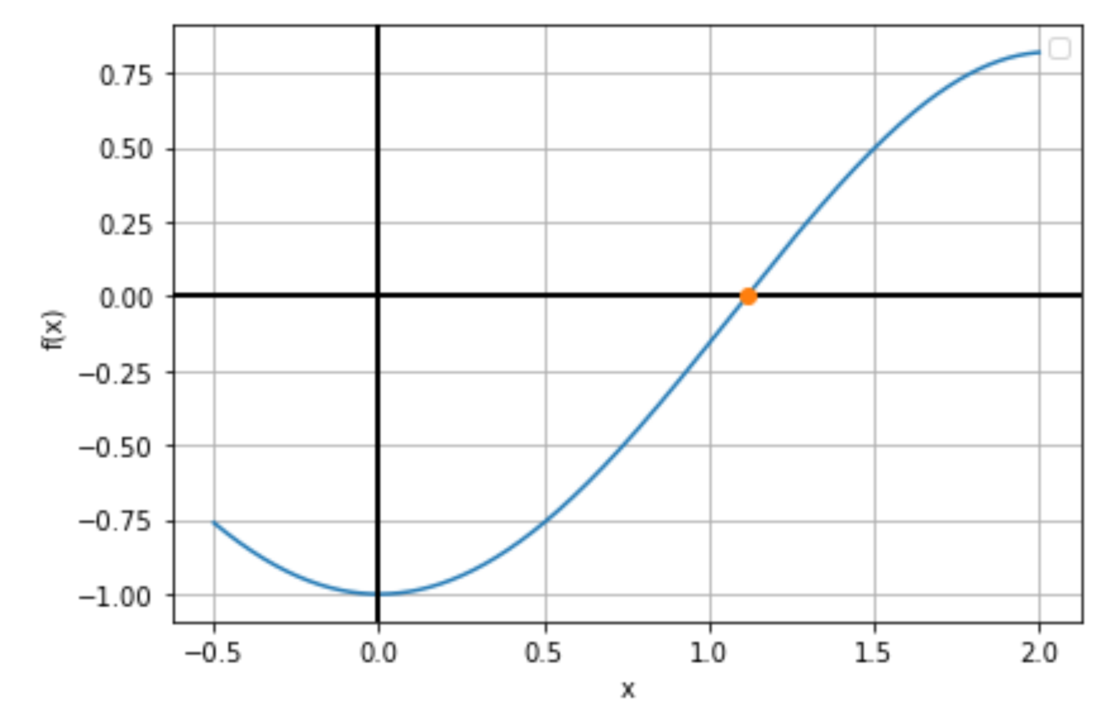
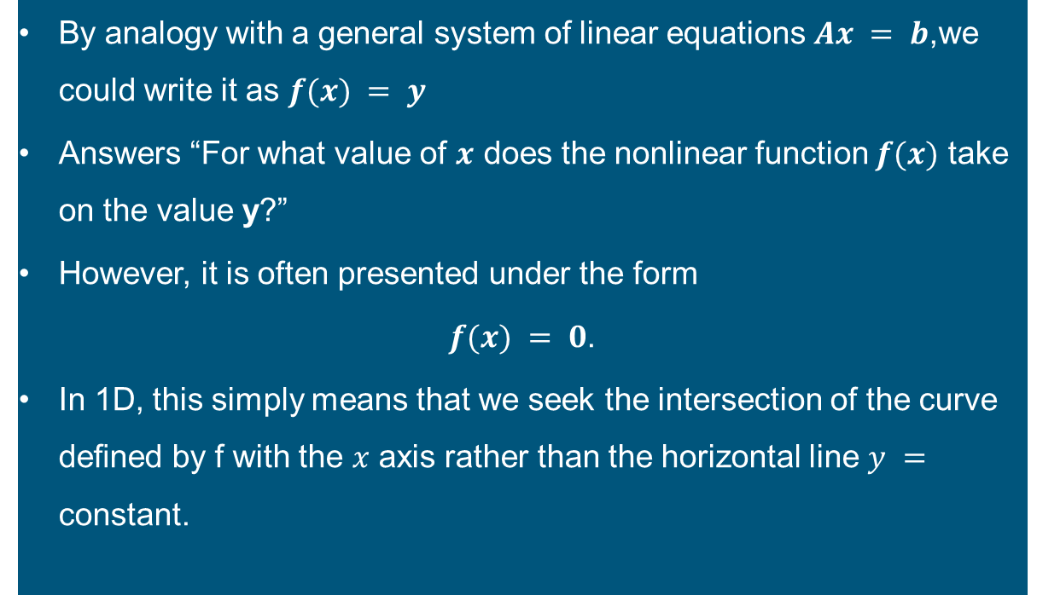
Non linear systems
By analogy with a general system of linear equations $Ax = b$,we could write it as $f(x) = y$
Answers “For what value of $x$ does the nonlinear function $f(x)$ take on the value y?”
However, it is often presented under the form
$f(x) = 0$.
In 1D, this simply means that we seek the intersection of the curve deﬁned by f with the $x$ axis rather than the horizontal line $y =$ constant.

Slide 6
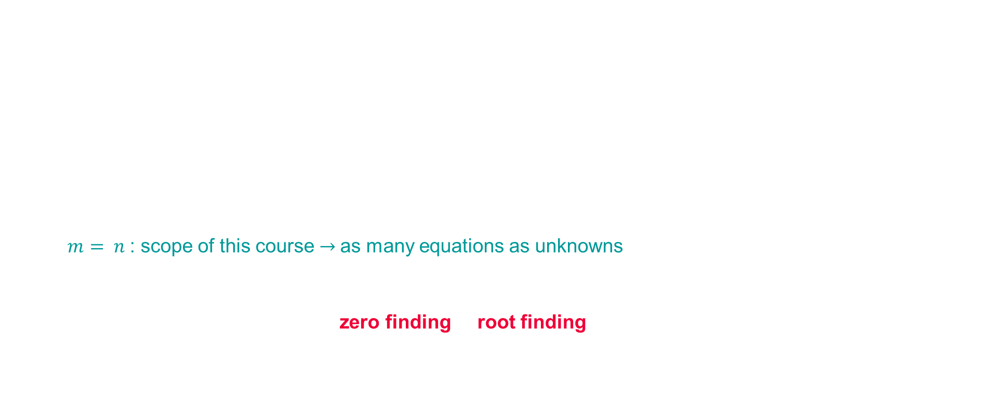
Root finding
Thus, a general system of m nonlinear equations in n unknowns has the form
$$f\left(x\right)= 0$$
where $f:ℝ_{n}→ℝ_{m}$, and we seek an $n$-vector $x$ such that all $m$component functions of $f\left(x\right)$ are zero simultaneously.
$m > n$: overdetermined - no solution in this strict sense $→$ approximation in least squares sense
$m< n$: underdetermined - inﬁnitely many solutions $→$optimization problem
$m= n$: scope of this course $→$as many equations as unknowns
A solution value $0$ such that $f\left(x\right)= 0$ is called a root of the equation, and a zero of the function $f$.
Thus, the problem is referred to as zero finding of root finding

Slide 7
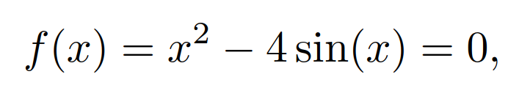
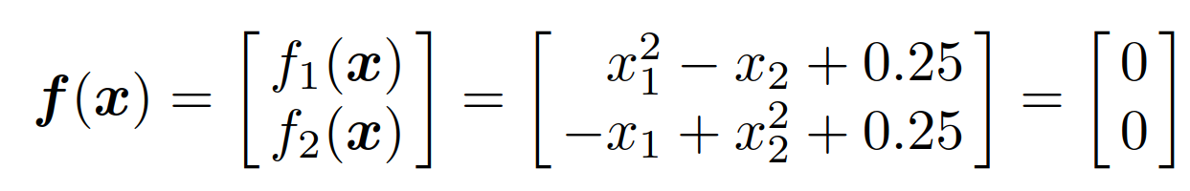

Root finding
An example of a nonlinear equation in one dimension is
for which one approximate solution is $x = 1.93375$. An example of a system of two nonlinear equations in two unknowns is
for which the solution vector is $x = {\left[ 0.5, 0.5 \right]}^{T}$ .
Each nonlinear equation $→$ “curved” hypersurface ( “ﬂat” hyperplane for a linear equation) in $ℝ_{n}$
Linear Equations $→$ 0,1 or $∞$ many solutions
Nonlinear equations $→$ any number of solutions.
Exercise 1

Slide 8
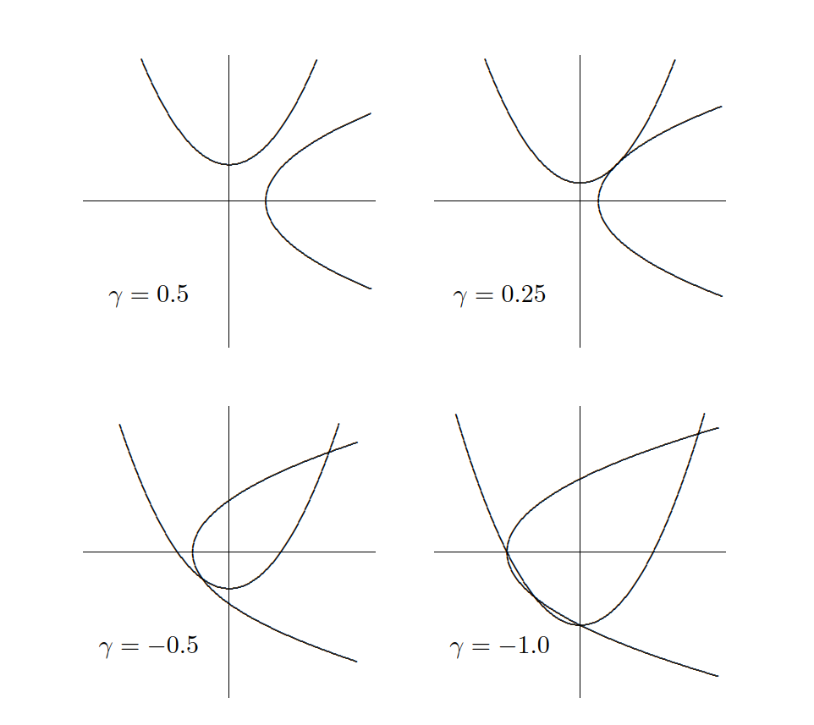
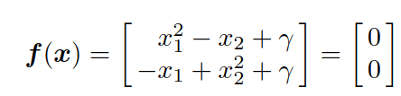
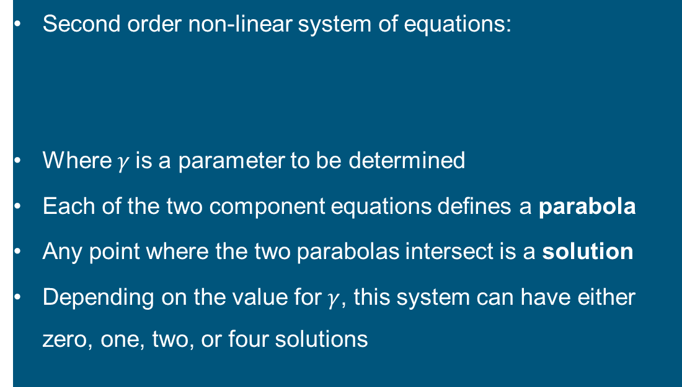
Geometrical interpretation
Second order non-linear system of equations:
Where $γ$is a parameter to be determined
Each of the two component equations deﬁnes a parabola
Any point where the two parabolas intersect is a solution
Depending on the value for $γ$, this system can have either zero, one, two, or four solutions

Slide 9
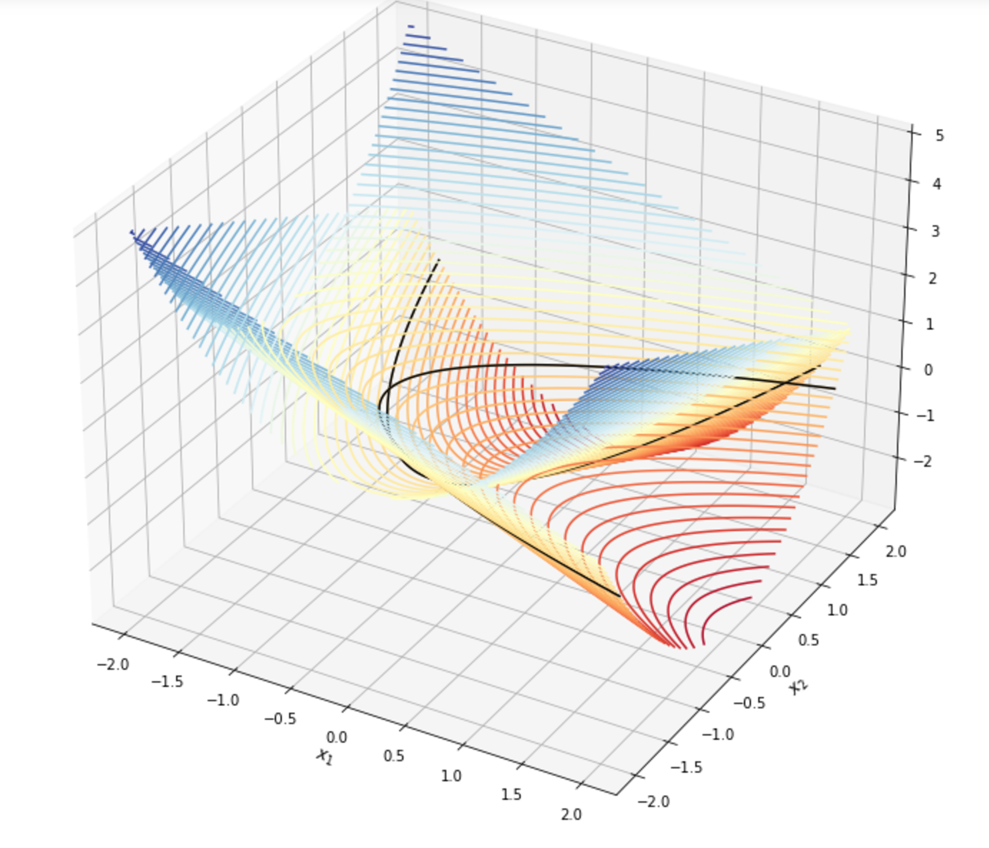
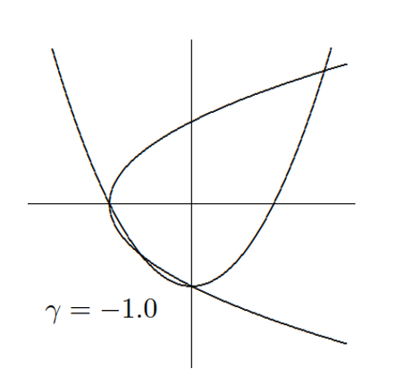
3D view:$γ=−1$

Slide 10
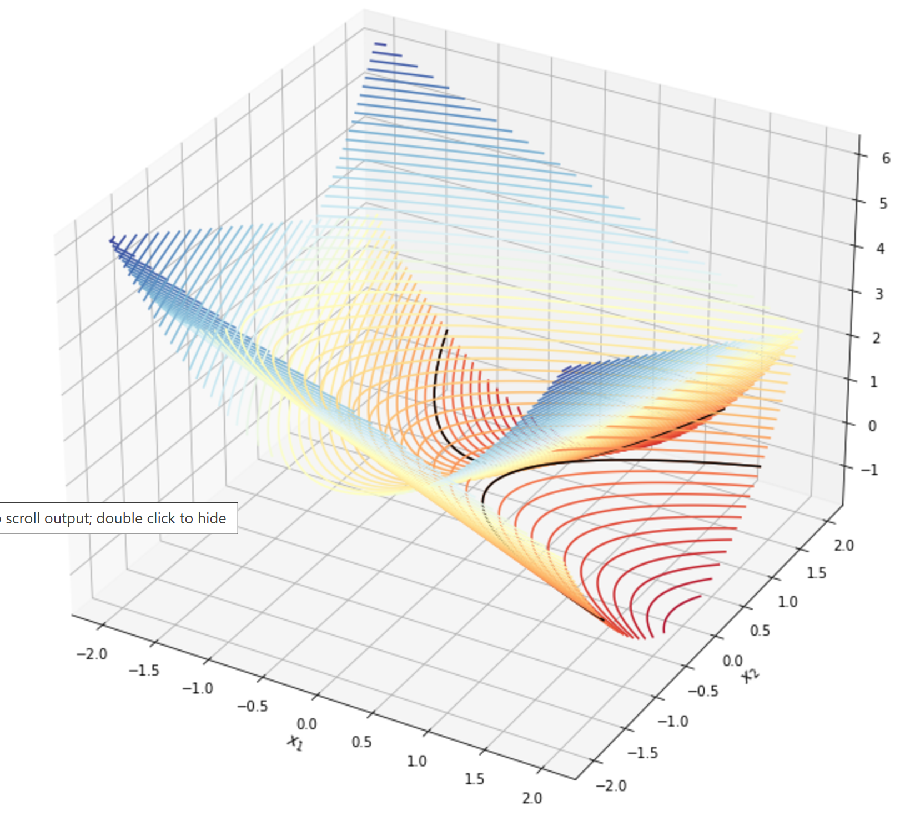
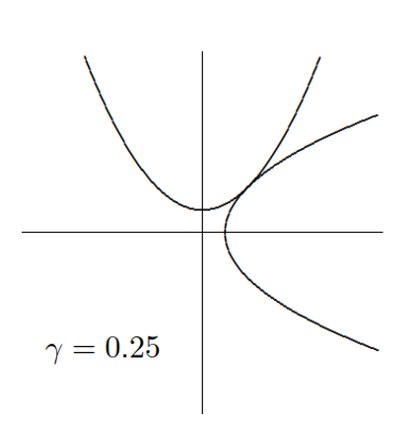
3D view:$γ=0.25$

Slide 11

Existence and Uniqueness
Intermediate Value Theorem:
if $f$ is continuous on a closed interval $[a, b]$, and $c$ lies between $f(a)$ and $f(b)$, then there is a value $x^{∗}∈ [a, b]$ such that $f(x^{∗})=c$.
Thus, if $f(a)$ and $f(b)$ diﬀer in sign, then by taking $c = 0$ in the theorem we can conclude that there must be a root within the interval $[a, b]$.
Such an interval $[a, b]$ for which the sign of $f$ diﬀers at its endpoints is called a bracket for a solution of the one-dimensional nonlinear equation $f(x) = 0$.
As we will see later, reﬁning such a bracket plays an important part in some algorithms for ﬁnding a solution.
Identifying such a bracket in the ﬁrst place, however, is often a matter of trial and error.

Slide 12

Existence and Uniqueness
Unlike linear equations, most nonlinear equations cannot be solved in a ﬁnite number of steps
The Jacobian matrix plays an important role in the solvability
$${\left\{ J_{f} \left(x\right) \right\}}_{ij} = ∂f_{i}(x)/∂x_{j}$$
If $J_{f} \left(x\right)$is nonsingular at a point $x^{∗}$, then there is a neighborhood of $f(x^{∗})$ in which $f$ is invertible, that is, the equation $f(x) = y$ has a solution for any $y$ in that neighborhood of $f(x^{∗})$.

Slide 13
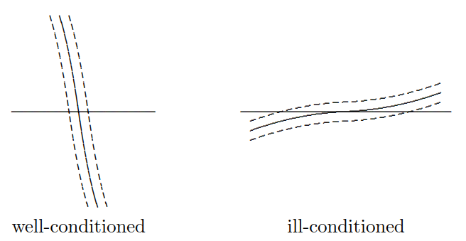
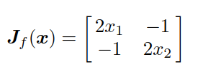

Conditioning and sensitivity
1D
The absolute condition number for root-ﬁnding problems in $n$-dimensions is $\left\{ J_{k}^{−1}\left(x\right) \right\}$
For the nonlinear system with $γ=0.25$, the Jacobian matrix
is singular at the unique solution $x^{∗}={\left[0.5, 0.5\right]}^{T}$.
slightly smaller $γ⇒$ 2 solutions
slightly larger $γ⇒$ no solution.
ill-conditioned
2D
Well-conditioned

Slide 14
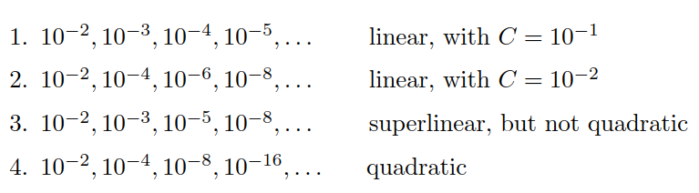
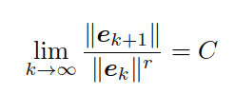
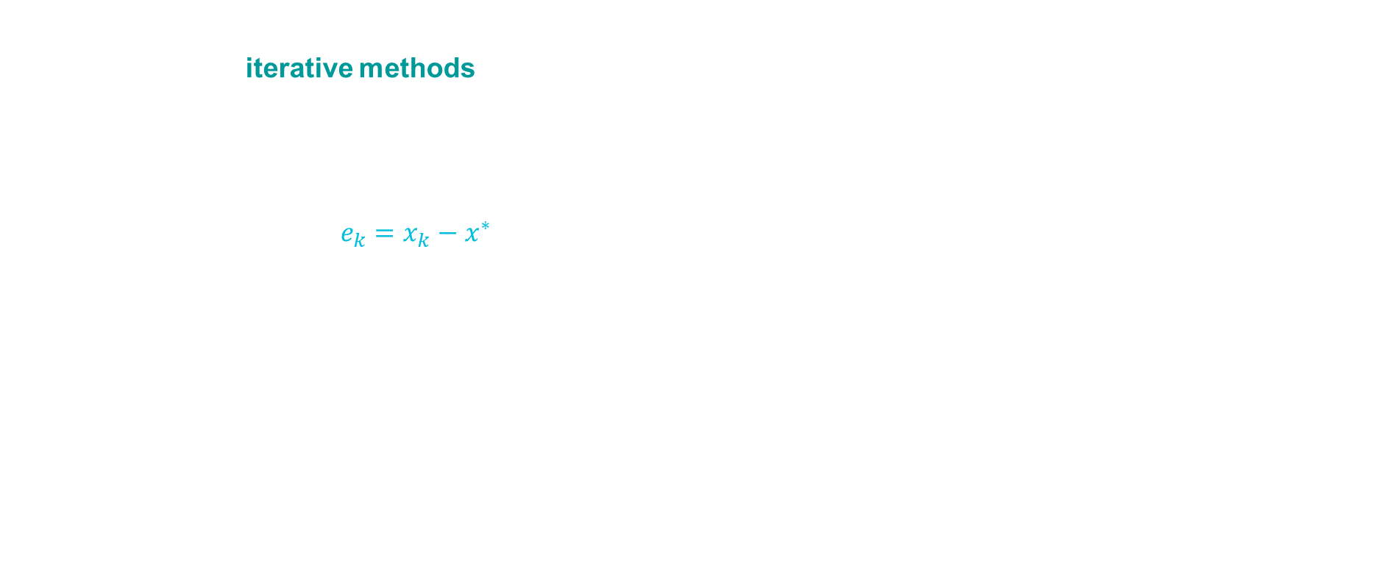
Convergence Rates and Stopping Criteria
Unlike linear equations, most nonlinear equations cannot be solved in a ﬁnite number of steps
we resort to iterative methods, and use a stopping criterion (look for stagnation)
Total cost = cost per iteration × $n_{iter} ⇒$Tradeoff between iteration cost and $n_{iter}$.
Convergence rate
Error at iteration k: $e_{k}=x_{k}−x^{∗}$, or interval length.
Convergence rate r:
Key Insight
Faster convergence rates (higher $r$) lead to significantly reduced iterations for high accuracy.
Quadratic convergence means that potentially after 6 or 7 iterations → machine precision

Slide 15
2. Standard algorithms (1D)

Slide 16

Preliminary analysis
Let us consider the following 1D equation
$$f\left(x\right)=0, x∈ℝ$$
where $f$is a real-valued function with one parameter.
We assume that this equation admits (at least) one root $x^{∗}$, such that $f (x^{∗}) = 0$.
The idea is to build a sequence ($x_{n}$) that converges towards $x^{∗}$.
Hence, the term $x_{n}$ of the sequence will be an approximation of $x^{∗}$, the accuracy depending on the choice of $n$
Main question?
How to build the sequence ($x_{n}$) ?

Slide 17

Preliminary analysis
Let us consider the following 1D equation
$$f\left(x\right)=0, x∈ℝ$$
where $f$is a real-valued function with one parameter.
Before using a numerical method, it is better (if possible)
to check that the equation has at least one solution
to determine the number of roots
to localize the roots i.e. to determine some intervals $[a , b]$in which the considered equation has one and only one solution

Slide 18
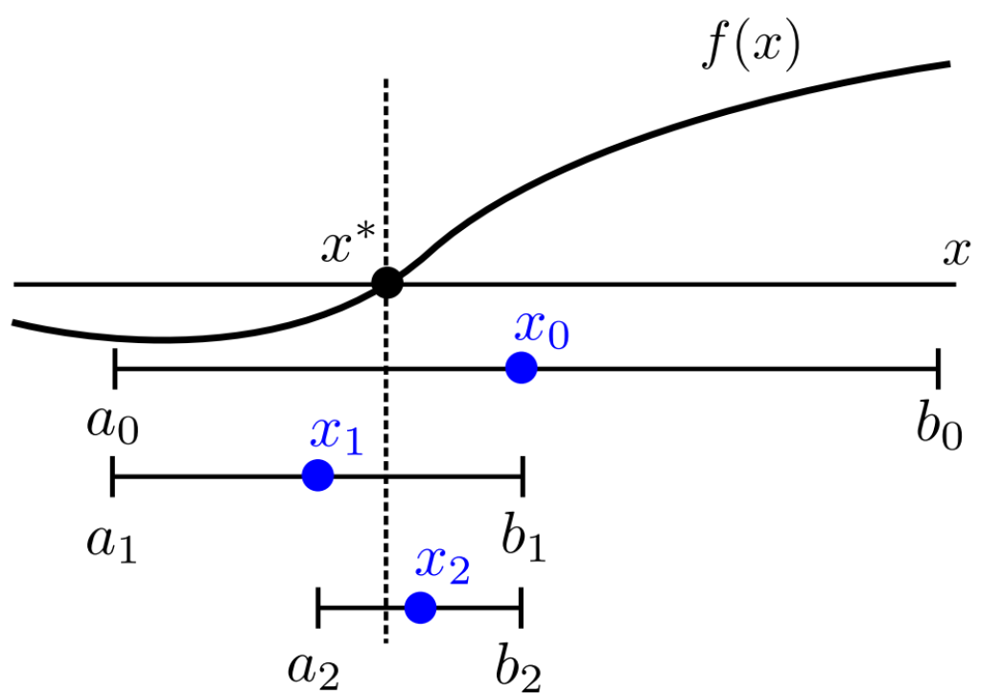

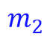
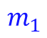
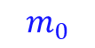
Bisection method
Principle of the method:
We seek a very short interval $[a,b]$ where $f$ changes of sign
To do so, we start with an initial interval that contains a root and we build a sequence of intervals such that
the root lies inside all the consecutive intervals (based on function sign switch)
the length of the intervals tends towards 0
One gets a converging process for localizing the roots by subdividing
$$m_{0}$$
$$m_{1}$$
$$m_{2}$$

Slide 19
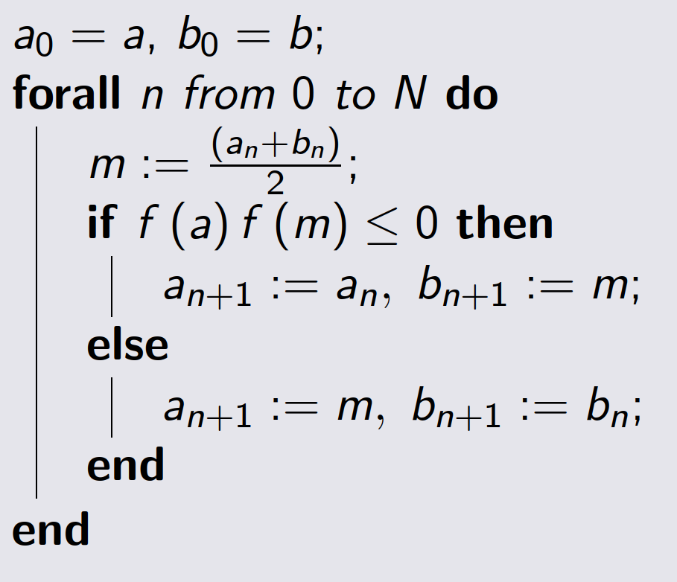
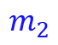
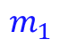

Bisection method
Pseudo-code
$$m_{0}$$
$$m_{1}$$
$$m_{2}$$
Exercise 2

Slide 20
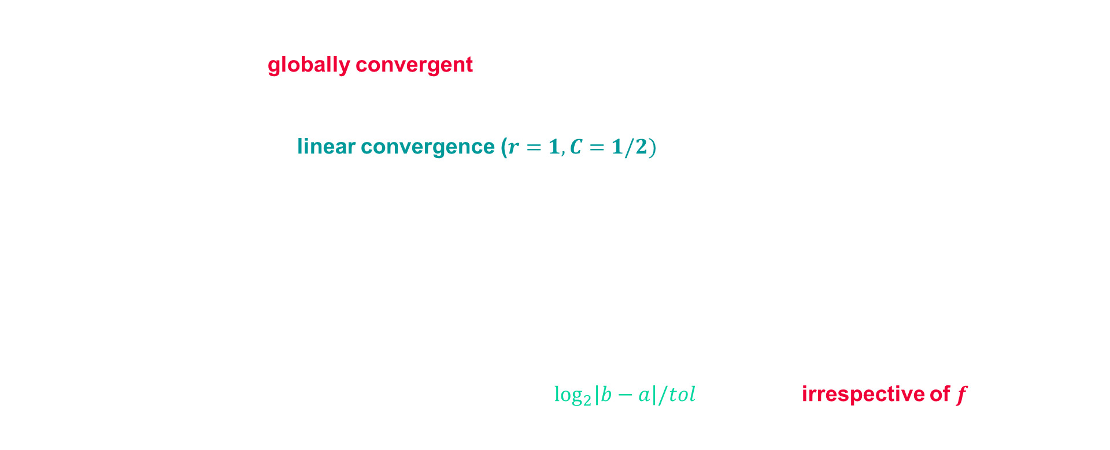
Bisection method
The bisection method makes no use of the magnitudes of the function values, only their signs
As a result, bisection is globally convergent (provided interval contains a root) but does so rather slowly
At each successive iteration, length of the interval containing the solution, and hence a bound on the possible error, is reduced by half $→$ linear convergence ($r=1, C=1/2)$
We have $a_{k} ≤x^{∗}≤ b_{k}, ∀k ≥ 0$, such that an upper bound for the error at iteration $k$:
$$\left|a_{k} −x^{∗}\right|≤\left|b_{k}−a_{k}\right|=\frac{|b−a|}{2^{k}}$$
Such that achieving an error tolerance of $tol$ requires $\log_{2}\left|b−a\right|/tol$ iterations, irrespective of $f$

Slide 21




Fixed-point iteration
If you type any number into a calculator and repeatedly hit the cosine button, the display eventually stops changing and gives you 0.739085
Given a function $g: ℝ → ℝ$, a value $x$ such that
$$g\left(x\right)=x$$
is called a fixed point of the function $g$
We seek a point where $g$ intersects the diagonal line
Fixed-point problems often arise directly in practice
But original problem are usually recast into their fixed-point form

Slide 22
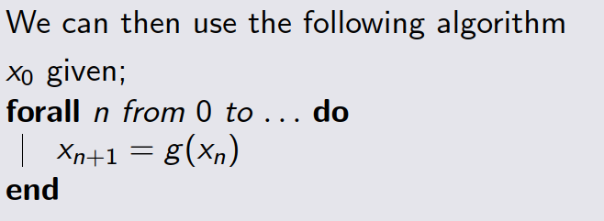

Fixed-point iteration
$→$ Just consists in repeatedly applying the fixed-form of non-linear equation $g(x)$ to an initial guess $x_{0}$
Pseudo-code

Slide 23
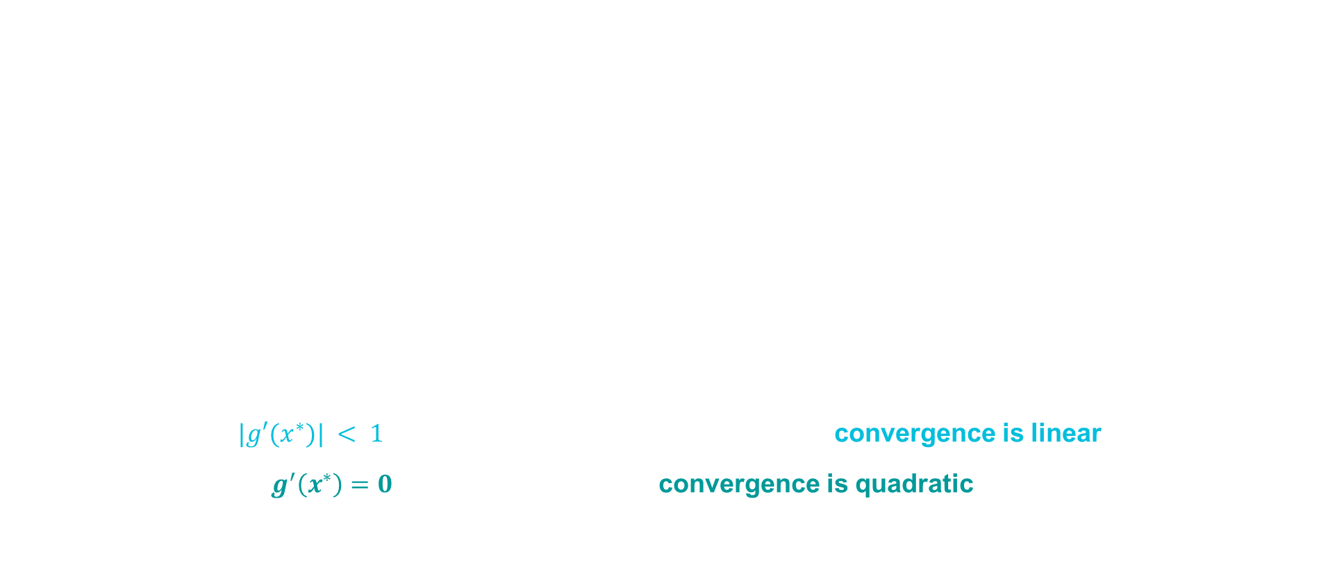
Fixed point iteration: convergence
If $x^{∗}$is a ﬁxed point, then for the error at the kth iteration we have
$$e_{k+1}= x_{k+1} − x^{∗} = g\left(x_{k}\right)− g\left(x^{∗}\right)$$
By the Mean Value Theorem, there is a point $θ_{k}$ between $x_{k}$ and $x^{∗}$ such that
$g(x_{k}) − g(x^{∗}) = g′(θ_{k})(x_{k} − x^{∗})$, so that $e_{k+1} =g′(θ_{k})e_{k}$
We do not know the value of $θ_{k}$, but if $|g′(x^{∗})| < 1$, then by starting the iterations close enough to $x^{∗}$, we can be assured that there is a constant $C$ such that $|g′(θ_{k})$|$≤C< 1$, for $k = 0, 1, . . .$
$$|e_{k}+1| ≤ C|e_{k}| ≤ · · · ≤C^{k}|e_{0}|$$
$C < 1$ implies $C_{k} → 0$, so $|e_{k}| → 0$ and the sequence converges
Hence provided $|g′(x^{∗})| < 1$ and we start close enough to the root, convergence is linear
In the special case $g^{′}\left(x^{∗}\right)=0$, we can show that the convergence is quadratic
$$g(x_{k}) − g(x^{∗}) = g′′(ξ_{k})(x_{k} − x^{∗})2/2$$

Slide 24
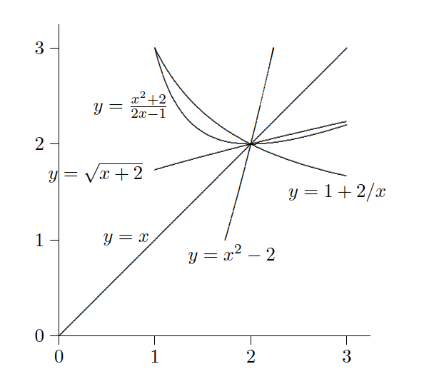
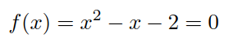
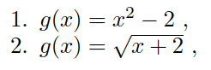
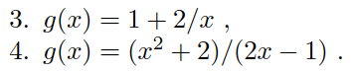


Fixed-point iteration
Consider the function
Which has roots $x^{∗}=2$ and $x^{∗}=−1$.
Equivalent ﬁxed-point problems include
exhibiting divergence, slow convergence or rapid convergence
If $|g′(x^{∗})| < 1$, then the iterative scheme
is locally convergent
Exercise 3

Slide 25
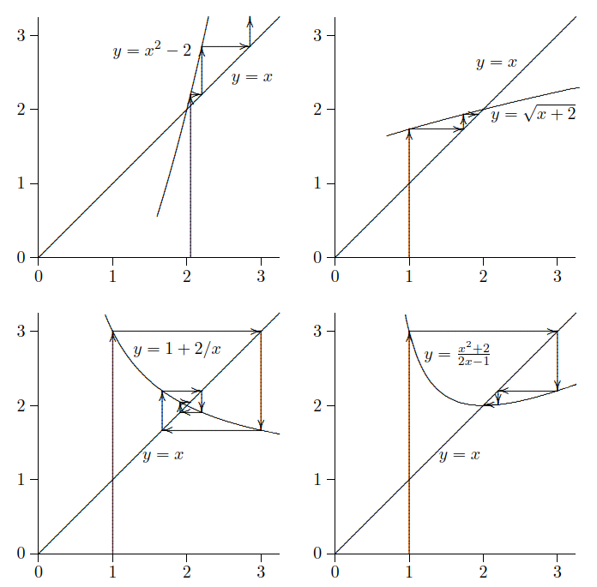
Fixed point iteration
Consider the function
Which has roots $x^{∗}=2$ and $x^{∗}=−1$.
Equivalent ﬁxed-point problems include
exhibiting divergence, slow convergence or rapid convergence

Slide 26


Fixed Point iteration
For a given equation $f(x) = 0$, there may be many equivalent ﬁxed-point prob-
lems $x = g(x)$ with diﬀerent choices for the function $g$
Not all ﬁxed-point formulations are equally useful in deriving an iteration scheme for solving a given nonlinear equation.
The resulting iteration schemes may diﬀer not only in their convergence rates but also in whether they converge at all.
If $|g′(x^{∗})| < 1$, then the iterative scheme is locally convergent

Slide 27
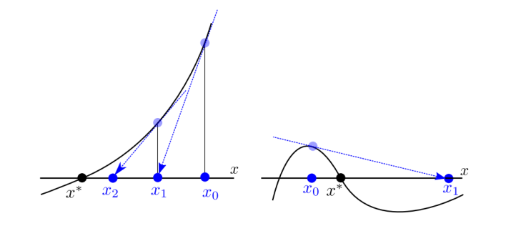
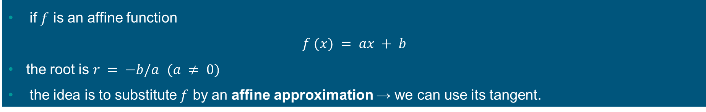
The Newton method
if $f$ is an affine function
$$f (x) = ax + b$$
the root is $r = −b/a$ $(a ≠ 0)$
the idea is to substitute $f$ by an affine approximation → we can use its tangent.

Slide 28
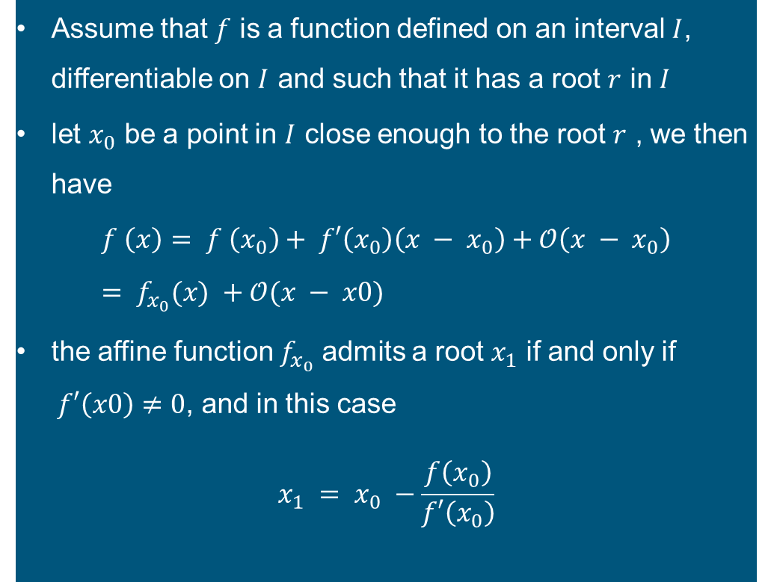

Newton: principle
Assume that $f$ is a function defined on an interval $I$, differentiable on $I$ and such that it has a root $r$ in $I$
let $x_{0}$ be a point in $I$ close enough to the root $r$ , we then have
$$f \left(x\right)= f \left(x_{0}\right)+ f′\left(x_{0}\right)\left(x − x_{0}\right)+𝒪\left(x − x_{0}\right)= f_{x_{0}}(x) +𝒪(x − x0)$$
the affine function $f_{x_{0}}$ admits a root $x_{1}$ if and only if $f′\left(x0\right)≠0$, and in this case
$$x_{1} = x_{0} −\frac{f\left(x_{0}\right)}{f′\left(x_{0}\right)}$$
$$f\left(x + h\right)≈ f\left(x\right)+ f^{′}\left(x\right)h$$
$f(x + h)≈$ 0 ➔ $h= −f(x)/ f′(x)$

Slide 29
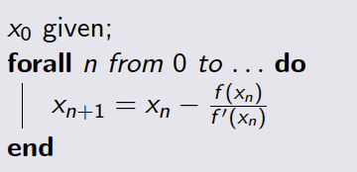

Newton: Pseudo code
$→$ Repeatedly subtracting function value divided by tangent to initial guess
Pseudo-code

Slide 30
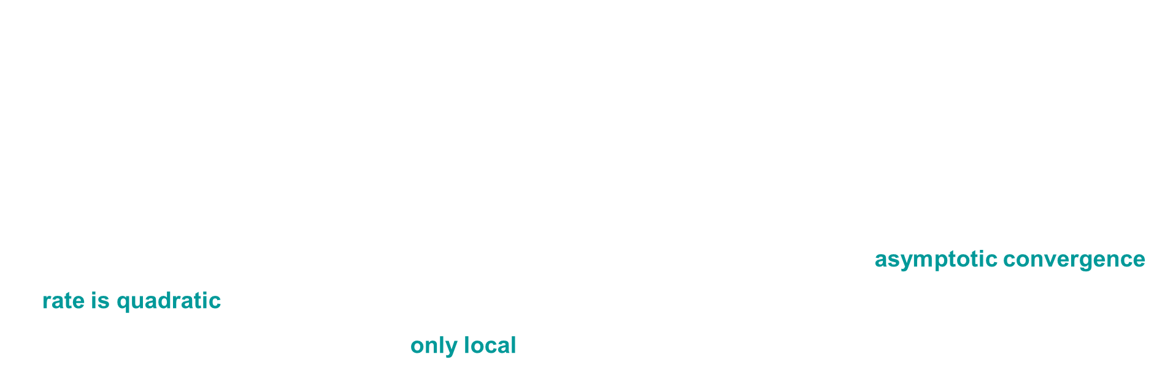
Newton: Convergence
We can view Newton’s method as a systematic way of transforming a nonlinear equation $f(x) = 0$ into a ﬁxed-point problem $x = g(x)$, where
$$g(x) = x − f(x)/f′(x)$$
To study the convergence of this scheme, we therefore determine the derivative
$$g′(x) = f\left(x\right)f′′(x)/{\left(f^{′}\left(x\right)\right)}^{2}$$
If $x^{∗}$ is a simple root (i.e., $f(x^{∗}) = 0$ and $f^{′}\left(x∗\right)≠0$), then $g′(x^{∗}) = 0$. Thus, the asymptotic convergence rate is quadratic (for a simple root)
However, this convergence result is only local Newton’s method may fail if not close enough to the solution

Slide 31
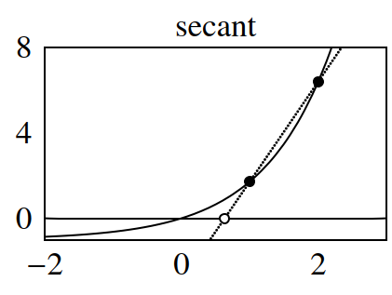
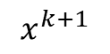

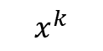

Secant method
Newton method $⇒$ point of intersection of the line of slope $f′(x^{k})$ passing through the point ($x^{k}$, $f(x^{k})$)
Determining the derivative $f′$ can be difficult analytically and numerically
But we can use other slopes $q^{k}$ that are suitable approximations to $f^{′}\left(x^{k}\right)$
$$x^{k+1}=x^{k}−\frac{f\left(x^{k}\right)}{q^{k}}$$
By taking the slope defined by two subsequent iterates
$$q^{k}=\frac{f\left(x^{k}\right)−f\left(x^{k−1}\right)}{x^{k}−x^{k−1}}$$
Advantage: Only one function evaluation per iteration
Drawback: order of convergence is about 1.63 - a bit lower than Newton’s method.
$$x^{k−1}$$
$$x^{k}$$
$$x^{k}$$
$$x^{k+1}$$
Exercise 4

Slide 32
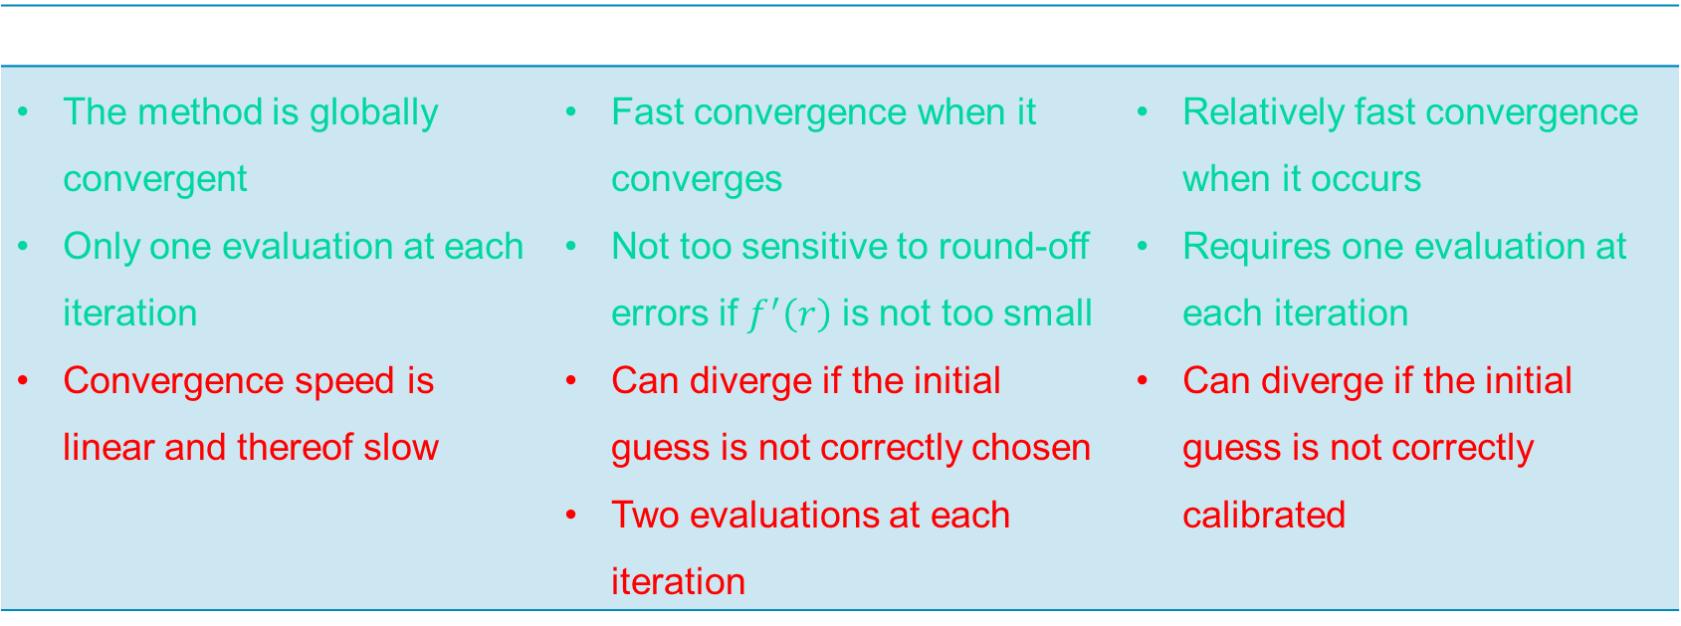
Comparison between the algorithms
Bisection | Newton | Secant
The method is globally convergent Only one evaluation at each iteration Convergence speed is linear and thereof slow | Fast convergence when it converges Not too sensitive to round-off errors if $f^{′}\left(r\right)$ is not too small Can diverge if the initial guess is not correctly chosen Two evaluations at each iteration | Relatively fast convergence when it occurs Requires one evaluation at each iteration Can diverge if the initial guess is not correctly calibrated

Slide 33
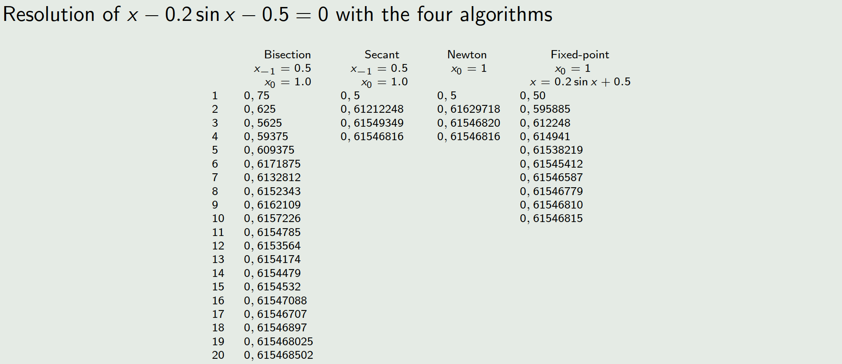
Example

Slide 34

Acceleration methods: Aitken’s formula
Given a sequence $\left\{x_{k}\right\}$ from a fixed-point iteration $x_{\left\{k+1\right\}}= g\left(x_{k}\right)$
Aitken’s accelerated sequence formula:
$$x_{k}^{\left\{\left(A\right)\right\}}= x_{k}− \left[\frac{{\left(x_{\left\{k+1\right\}}− x_{k}\right)}^{2}}{\left(x_{\left\{k+2\right\}}− 2x_{\left\{k+1\right\}}+ x_{k}\right)}\right]$$
Algorithm Steps:
Perform standard fixed-point iterations to generate $x_{k}, x_{\left\{k+1\right\}}, x_{\left\{k+2\right\}}$.
Apply Aitken’s formula to compute $x_{k}^{\left\{\left(A\right)\right\}}$ & use as updated approximation for subsequent iterations.
Benefits:
Faster convergence when the sequence is close to a fixed point.
Computationally inexpensive to implement.
Limitations:
Requires three consecutive iterates $\left(x_{k}, x_{\left\{k+1\right\}}, x_{\left\{k+2\right\}}\right)$
Sensitive to numerical errors if denominator ≈ 0.

Slide 35
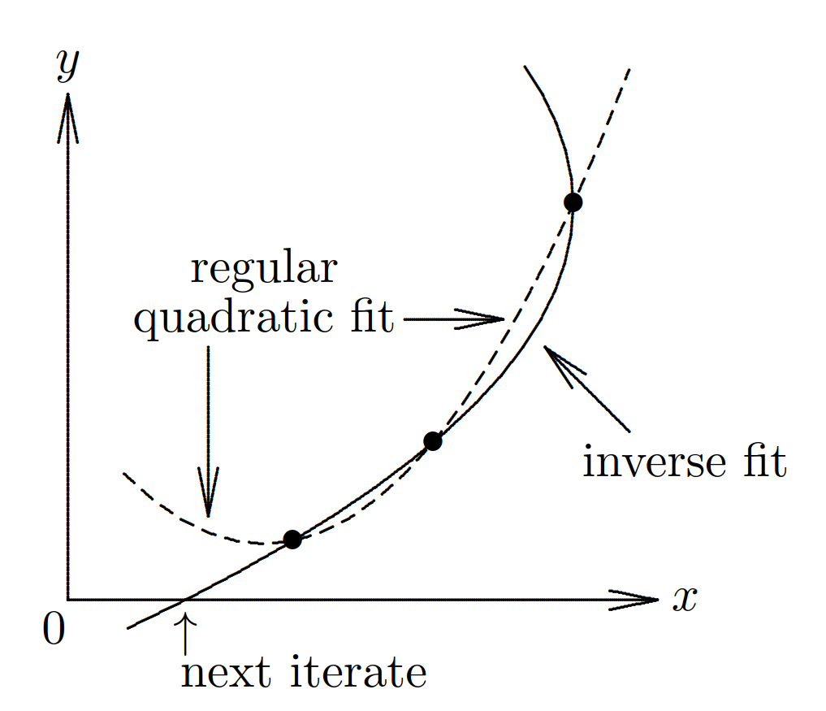
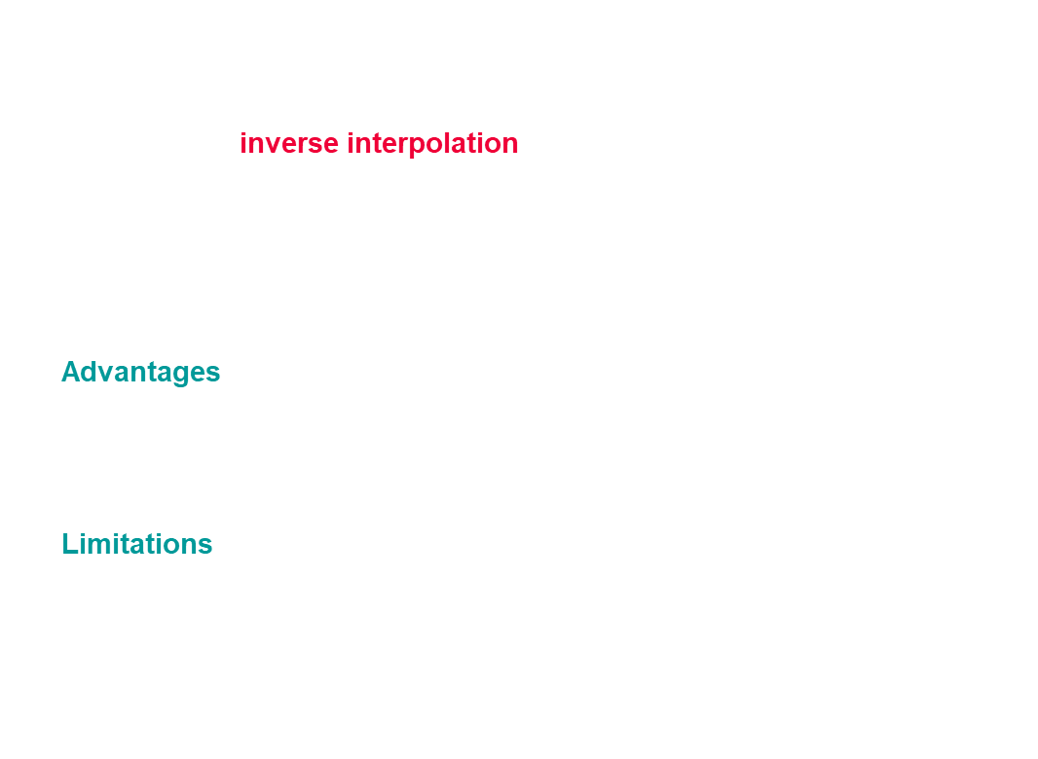
Inverse quadratic interpolation
Given three points $\left(x1, f\left(x1\right)\right), \left(x2, f\left(x2\right)\right), \left(x3, f\left(x3\right)\right)$, construct a quadratic function that passes through these points.
Best is to use inverse interpolation, in which one
ﬁts the values $x_{k}$ as a function of the values $y_{k} = f(x_{k})$
by a polynomial $p\left(y\right)$
next approximate solution is simply $p(0)$
Advantages:
Faster convergence than linear interpolation (e.g., Secant method).
No need for derivative evaluations.
Limitations:
Requires three distinct points
Sensitive to numerical instability if points are close together

Slide 36
Safeguarded methods
Dilemma:
Rapidly convergent methods (e.g., Newton's, Secant) are unsafe unless started close to the solution.
Safe methods (e.g., Bisection) are slow and costly.
Solution:
Use hybrid methods that combine features of both.
Example: Use a rapidly convergent method but maintain a bracket around the solution.
If the next approximate solution falls outside the bracket, fall back to a safe method (e.g., Bisection).
Try the rapid method again on a smaller interval. Fast convergence usually prevails.
Popular Implementation:
Brent’s method: Combines safety of Bisection with faster convergence of inverse quadratic interpolation.
https://docs.scipy.org/doc/scipy/reference/generated/scipy.optimize.brentq.html
Avoids Newton's method, so derivatives are not required.
Addresses potential pitfalls in floating-point arithmetic (e.g., underflow, overflows, tight tolerances).

Slide 37
3. Systems of non linear equations

Slide 38
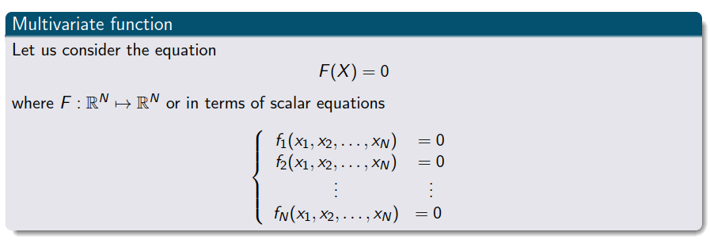

Problem description
$$x^{k}$$
Let us consider the equation
$$F\left(X\right)=0$$
Where $F:ℝ_{n}→ℝ_{n}$ or in terms of scalar equations

Slide 39
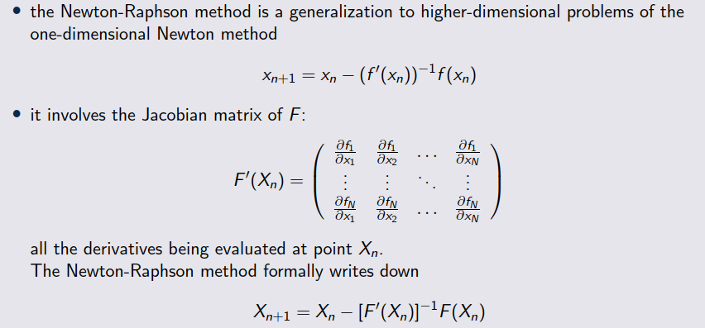
Newton-Raphson method

Slide 40
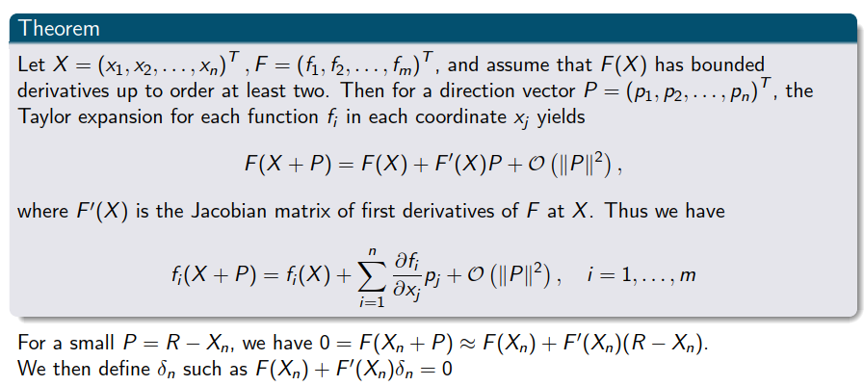
Taylor Series for vector functions

Slide 41
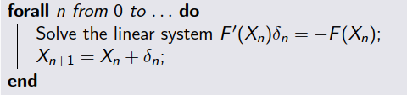

The Newton-Raphson method
In a practical computation, we do not explicitly compute the inverse of the Jacobian matrix which would be too expensive
We prefer to write the algorithm under the following form
For $X_{0}$ given
Pseudo-code

Slide 42

Remarks
The choice of the initial guess is crucial and the risk that the algorithm diverges truly exists
The convergence is second-order and therefore is really fast (when it converges!)
The Newton Raphson method is expensive at each iteration, one must
Evaluate $N^{2}+N$ functions ($N^{2}$ Jacobian matrix and $N$ coordinate functions)
Solve the linear system of size $N×N$ (with a dense matrix)
Exercise 6 and 7

Slide 43
3. Summary

Slide 44
Summary
We have seen a few methods to find roots of 1D non-linear equations.
the fixed-point theory is a fundamental concept to develop algorithms,
they are methods to accelerate convergence (Aitken-acceleration)
built-in methods combine the bisection, Newton and secant methods
In two or more dimensions the situation is more complicated
Newton method can still be used, but is very costly
Cheaper methods can be devised by approximating the Jacobian
Root-finding is strongly linked to optimization

